Slide 1
Introduction to Software Engineering
Rakibul Hassan
Lecturer
Dept. of ECE, RUET

Slide 2
What is a software?
A program is an executable code, which serves some computational purpose.
Software is more than just a program code.
Software is considered to be collection of executable programming code, associated libraries and documentations.
Software, when made for a specific requirement is called software product.

Slide 3
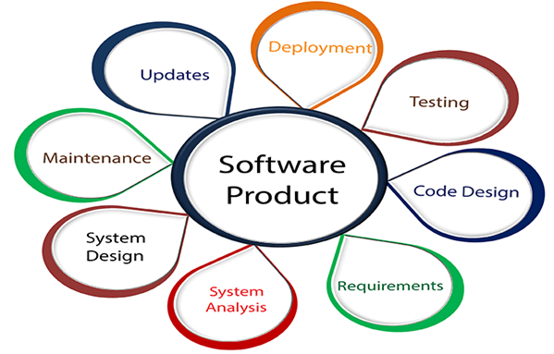
Software Engineering
Engineering is all about developing products, using well-defined, scientific principles and methods.
Software Engineering is an engineering branch related to the evolution of software product using well-defined scientific principles, techniques, and procedures. The result of software engineering is an effective and reliable software product.

Slide 4
Software Engineering
IEEE, in its standard 610.12-1990, defines software engineering as the application of a systematic, disciplined, which is a computable approach for the development, operation, and maintenance of software
Boehm defines software engineering, which involves, 'the practical application of scientific knowledge to the creative design and building of computer programs. It also includes associated documentation needed for developing, operating, and maintaining them.'

Slide 5
Why do we need Software Engineering?
To manage Large software
For more Scalability
Cost Management
To manage the dynamic nature of software
For better quality Management

Slide 6
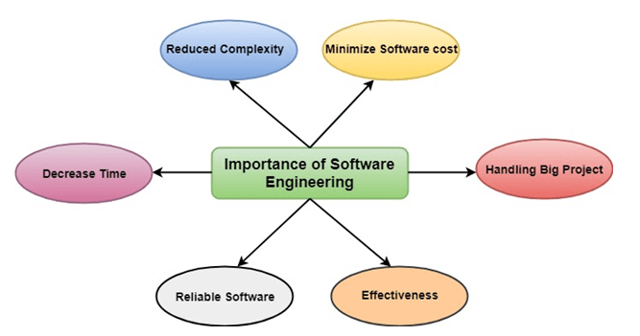
Why do we need Software Engineering?
To manage Large software
For more Scalability
Cost Management
To manage the dynamic nature of software
For better quality Management

Slide 7
Characteristics of a good software
A software product can be judged by what it offers and how well it can be used.
A software must satisfy on the following grounds:
Operational
Transitional
Maintenance

Slide 8
Characteristics of a good software
Operational
This tells us how well software works in operations. It can be measured on:
Budget
Usability
Efficiency
Correctness
Functionality
Dependability
Security
Safety

Slide 9
Characteristics of a good software
Transitional
This aspect is important when the software is moved from one platform to another:
Portability
Interoperability
Reusability
Adaptability

Slide 10
Characteristics of a good software
Maintenance
This aspect talks about how well software has the capabilities to adapt itself in the quickly changing environment:
Flexibility
Maintainability
Modularity
Scalability

Slide 11
Characteristics of a good software Engineer
Exposure to systematic methods, i.e., familiarity with software engineering principles.
Good technical knowledge of the project range (Domain knowledge).
Good programming abilities.
Good communication skills. These skills comprise of oral, written, and interpersonal skills.

Slide 12
Characteristics of a good software Engineer
High motivation.
Sound knowledge of fundamentals of computer science.
Intelligence.
Ability to work in a team
Discipline

Slide 13
Software development life cycle (SDLC)
Software Development Life Cycle, SDLC for short, is a well-defined, structured sequence of stages in software engineering to develop the intended software product.
SDLC is a systematic process for building software that ensures the quality and correctness of the software built.
SDLC process aims to produce high-quality software that meets customer expectations.

Slide 14
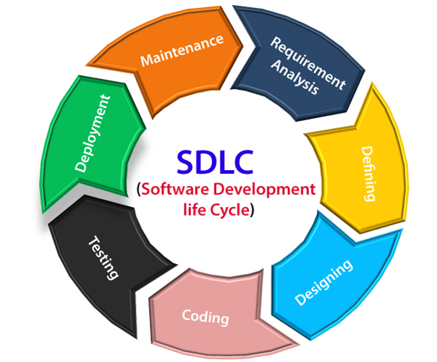
SDLC Stages
Phase 1: Requirement collection and analysis
Phase 2: Feasibility study:
Phase 3: Design:
Phase 4: Coding:
Phase 5: Testing:
Phase 6: Installation/Deployment:
Phase 7: Maintenance:

Slide 15
SDLC Stages
Requirement collection and analysis
It is conducted by the senior team members with inputs from all the stakeholders and domain experts in the industry.
Planning for the quality assurance requirements and recognization of the risks.
Getting clearer picture of the scope of the entire project and the anticipated issues, opportunities, and directives which triggered the project.
Requirements Gathering need teams to get detailed and precise requirements. This helps companies to finalize the necessary timeline to finish the work of that system.

Slide 16
SDLC Stages
Feasibility study
At this stage we define and document software needs.
This process is conducted with the help of 'Software Requirement Specification' document also known as 'SRS' document.
It includes everything which should be designed and developed during the project life cycle.

Slide 17
SDLC Stages
Feasibility study
There are mainly five types of feasibilities checks:
Economic: Can we complete the project within the budget or not?
Legal: Can we handle this project as cyber law and other regulatory framework/compliances.
Operation feasibility: Can we create operations which is expected by the client?
Technical: Need to check whether the current computer system can support the software
Schedule: Decide that the project can be completed within the given schedule or not.

Slide 18
SDLC Stages
Design
In this third phase, the system and software design documents are prepared as per the requirement specification document. This helps define overall system architecture.
This design phase serves as input for the next phase of the model.
There are two kinds of design documents developed in this phase:
High-Level Design (HLD)
Low-Level Design(LLD)

Slide 19
SDLC Stages
Design
High-Level Design (HLD)
Brief description and name of each module
An outline about the functionality of every module
Interface relationship and dependencies between modules
Database tables identified along with their key elements
Complete architecture diagrams along with technology details

Slide 20
SDLC Stages
Design
Low-Level Design (LLD)
Functional logic of the modules
Database tables, which include type and size
Complete detail of the interface
Addresses all types of dependency issues
Listing of error messages
Complete input and outputs for every module

Slide 21
SDLC Stages
Coding
Once the system design phase is over, the next phase is coding. In this phase, developers start build the entire system by writing code using the chosen programming language. In the coding phase, tasks are divided into units or modules and assigned to the various developers. It is the longest phase of the Software Development Life Cycle process.
In this phase, Developer needs to follow certain predefined coding guidelines. They also need to use programming tools like compiler, interpreters, debugger to generate and implement the code.

Slide 22
SDLC Stages
Testing
Once the software is complete, and it is deployed in the testing environment. The testing team starts testing the functionality of the entire system. This is done to verify that the entire application works according to the customer requirement.
During this phase, QA and testing team may find some bugs/defects which they communicate to developers. The development team fixes the bug and send back to QA for a re-test. This process continues until the software is bug-free, stable, and working according to the business needs of that system.

Slide 23
SDLC Stages
Installation/Deployment:
Once the software testing phase is over and no bugs or errors left in the system then the final deployment process starts. Based on the feedback given by the project manager, the final software is released and checked for deployment issues if any.

Slide 24
SDLC Stages
Maintenance:
Once the system is deployed, and customers start using the developed system, following 3 activities occur
Bug fixing - bugs are reported because of some scenarios which are not tested at all
Upgrade - Upgrading the application to the newer versions of the Software
Enhancement - Adding some new features into the existing software

Slide 25
Thank you

